Slide 1






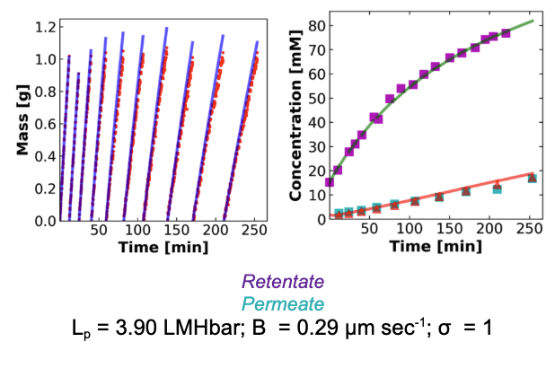
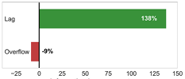


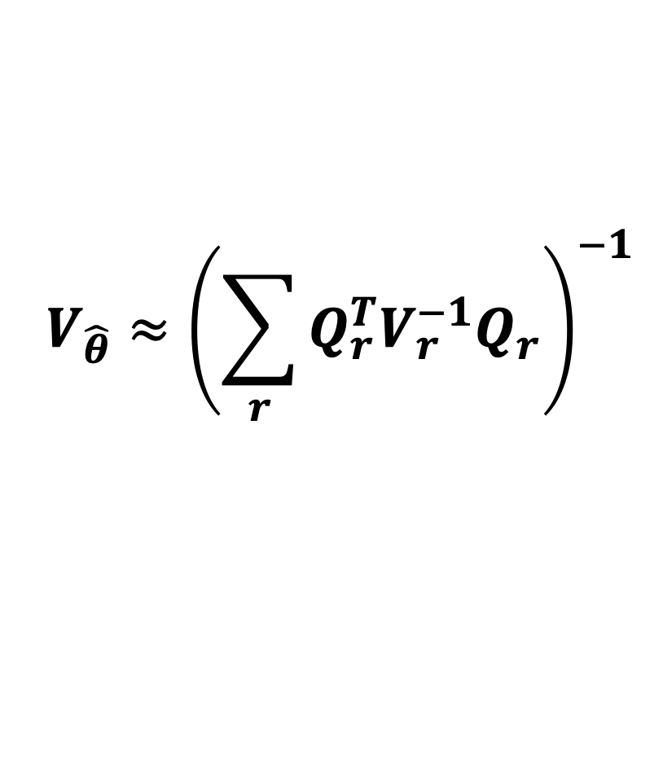
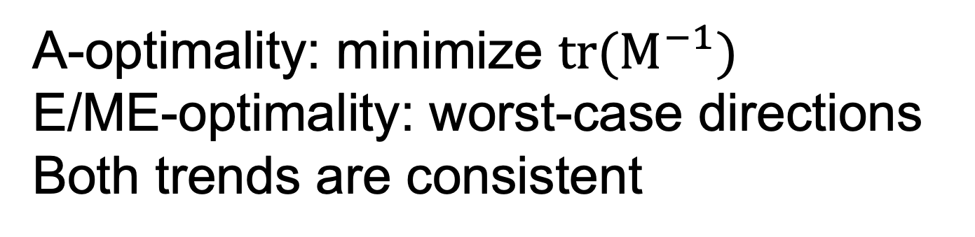
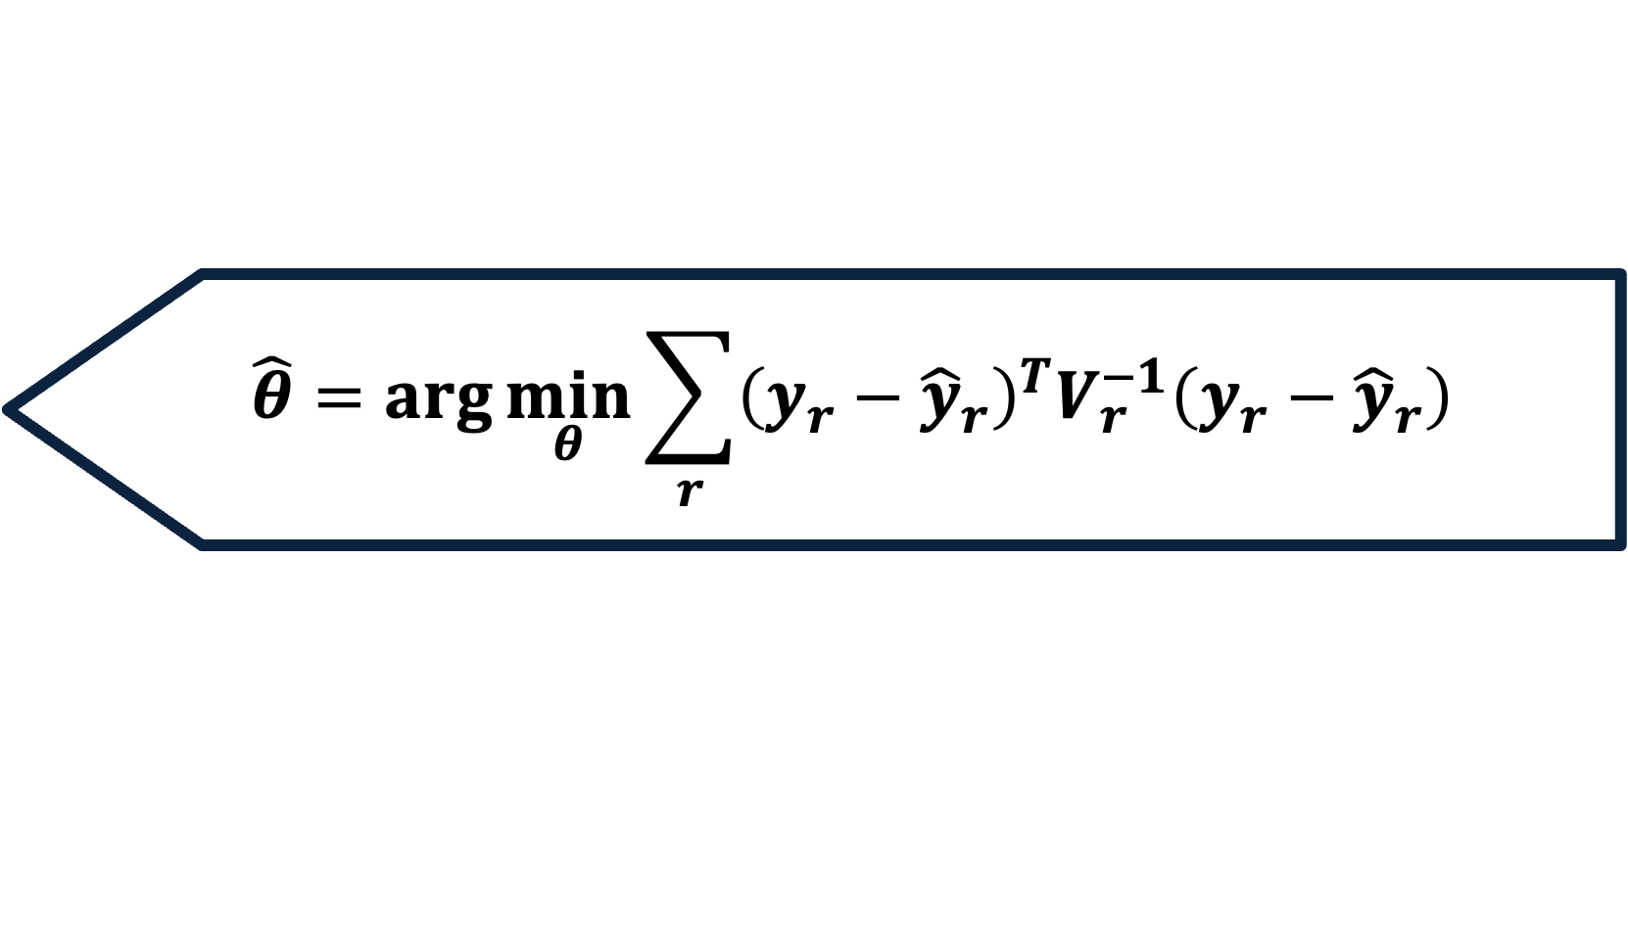
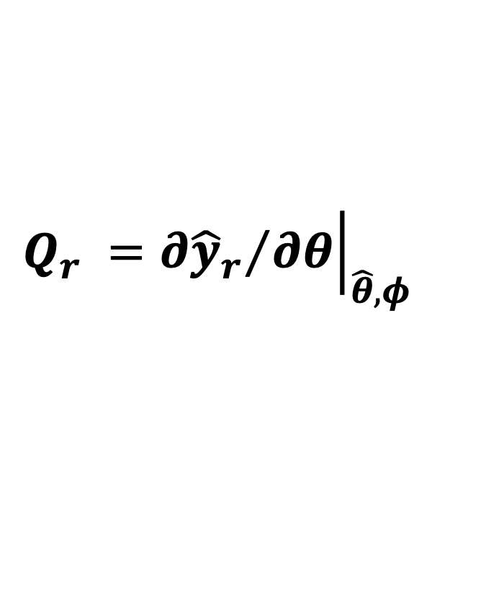
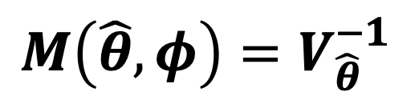

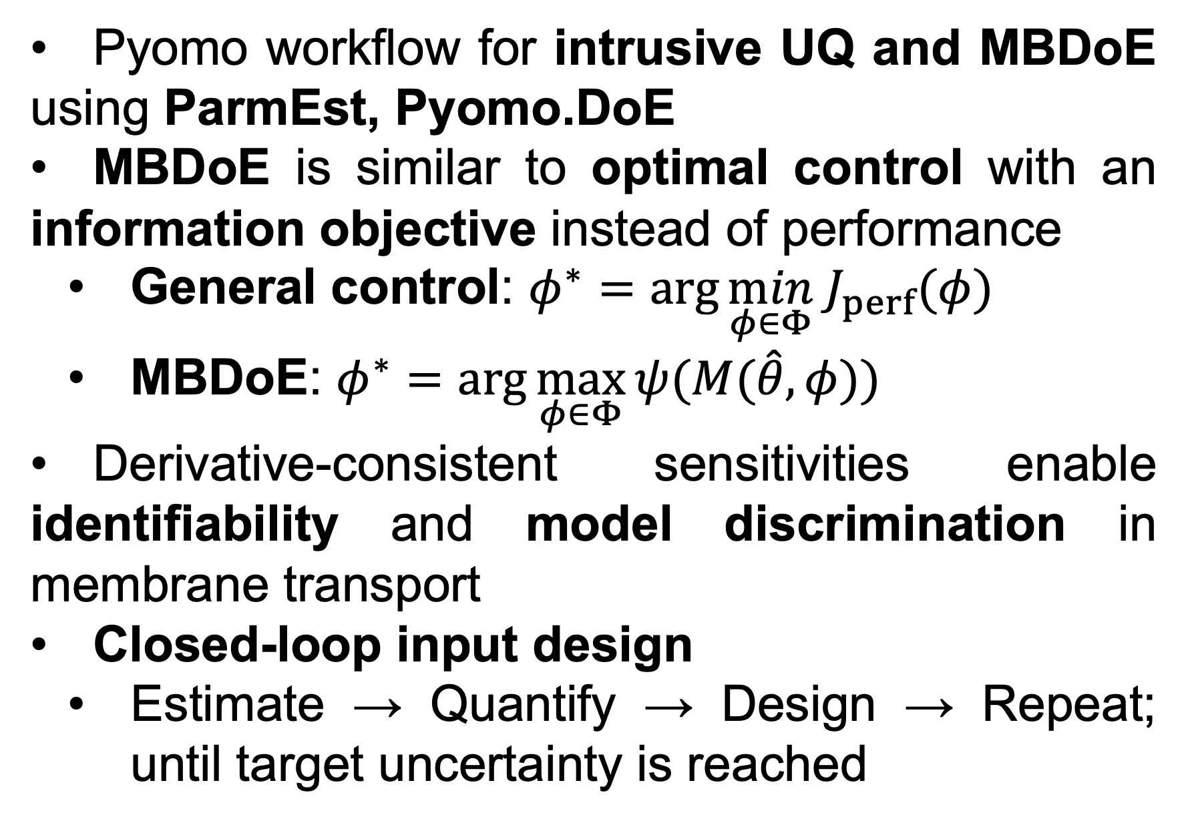


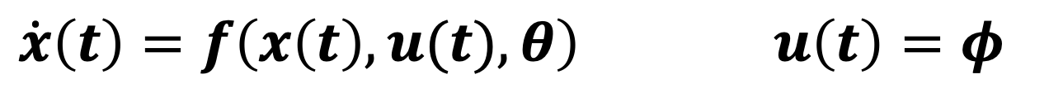
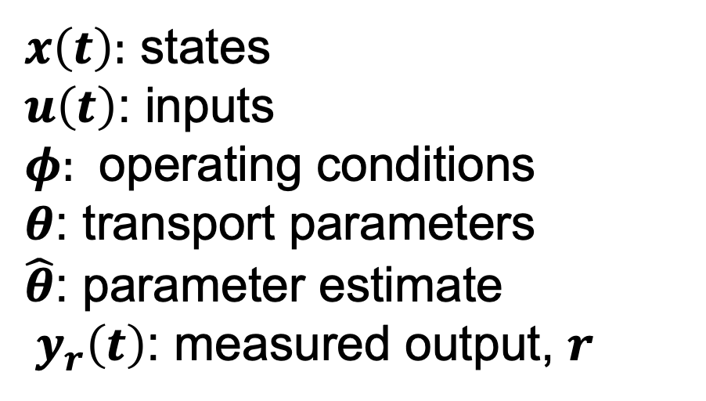
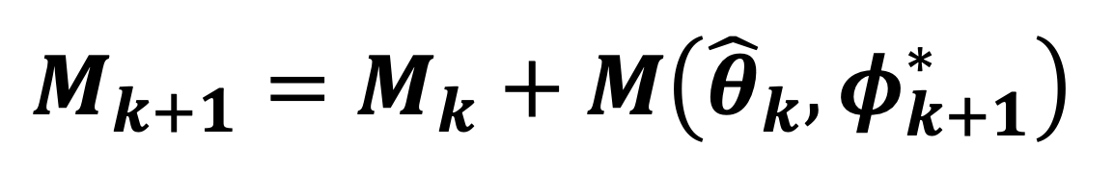
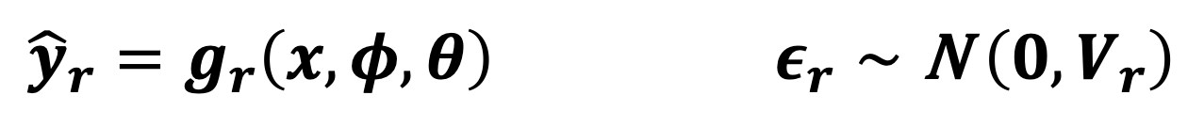
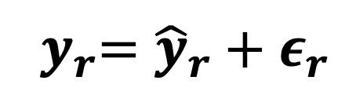
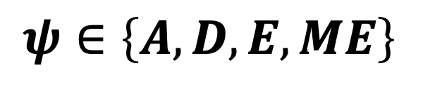
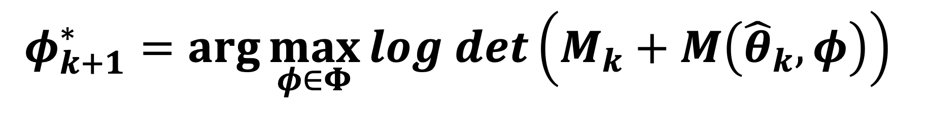
Dynamic Modeling and Intrusive Uncertainty Quantification (UQ) for Membrane Separation Systems
Keshav Kasturi Rangan, Molly Dougher, Laurianne Estrada, Shammah Lilonfe, Pratham Singh, William A. Phillip, Alexander W. Dowling Department of Chemical and Biomolecular Engineering, University of Notre Dame
Email: kkasturi@nd.edu
Objective
Dynamic Modeling and UQ Workflow
Takeaways
Optimize the identification of the most-informative operating conditions
Develop a dynamic, equation-oriented model using experimental data
Compute model-consistent uncertainty using intrusive derivatives
Design the next experiment to maximally reduce uncertainty
Validate using a membrane separation experiment and generalize
Mechanistic Dynamic Model
$$\dot{x}\left(t\right)=f\left(x\left(t\right),u(t),θ\right) u\left(t\right)=φ$$
Pyomo workflow for intrusive UQ and MBDoE using ParmEst, Pyomo.DoE
MBDoE is similar to optimal control with an information objective instead of performance
General control: $φ^{∗}=\arg{\min_{φ∈Φ} J_{perf}(φ)}$
MBDoE: $φ^{∗}=\arg{\max_{φ∈Φ}{ψ(M(\hat{θ},φ))}}$
Derivative-consistent sensitivities enable identifiability and model discrimination in membrane transport
Closed-loop input design
Estimate → Quantify → Design → Repeat; until target uncertainty is reached
${\hat{y}}_{r}=g_{r}\left(x,φ,θ\right)$ $ε_{r}∼\text{N} \left(0,V_{r}\right)$
$${ y}_{r}={\hat{y}}_{r}+ε_{r}$$
Parameter Estimation
$$\hat{θ}=\arg{\min_{θ}{\sum_{r}{{\left(y_{r}−{\hat{y}}_{r}\right)}^{T}V_{r}^{−1}\left(y_{r}−{\hat{y}}_{r}\right)}}}$$
Motivation
Intrusive UQ: Covariance/FIM
$$Q_{r} ={\left.{∂{\hat{y}}_{r}}/{∂θ}\right|}_{\hat{θ},φ}$$
$$V_{\hat{θ}}≈{\left(\sum_{r}{Q_{r}^{T}V_{r}^{−1}Q_{r}}\right)}^{−1}$$
Impactful applications
Water treatment
Chemical manufacturing
Critical-material recovery
Membrane systems modeling limitations
Uncertainty in transport models
Poor parameter identifiability
Impact on process design
Degraded prediction accuracy
Unreliable scalability
$$M\left(\hat{θ},φ\right)=V_{\hat{θ}}^{−1}$$
Operating Condition: MBDoE
$φ^{∗}=\arg{\max_{φ∈Φ}{ψ\left(M\left(\hat{θ},φ\right)\right)}}$
Legend
$$ψ∈\left\{A,D,E,ME\right\}$$
$x\left(t\right):$ states
$u\left(t\right)$: inputs
$φ:$ operating conditions
$θ$: transport parameters
$\hat{θ}$: parameter estimate
${ y}_{r}\left(t\right)$: measured output, $r$
$\text{N} \left(0,V_{r}\right)$: noise
$V_{r}:$measurement covariance
$Q_{r}$: sensitivity (UQ)
$M(\hat{θ})$: FIM
$k$: sequential experiment index
$Φ$: feasible design space
Stopping Criterion
$$tr({M\left(\hat{θ},φ\right)}_{k}^{−1})≤τ$$
ParmEst
ParmEst
Prior
Knowledge
Experimental Data
Parameter Estimation
Weighted Sum of
Sensitivity & Uncertainty Analysis
Squared Errors (WSSE)
Central Finite Difference
D‑optimality (maximize $det(M)$) metric
Uncertainty Acceptable?
Model with Quantified Uncertainty
Yes
Model(s)
No
A‑optimality: minimize $tr(M^{−1})$
E/ME‑optimality: worst‑case directions
Both trends are consistent
Model-Based Design of Experiments
$$M_{k+1}=M_{k}+M\left({\hat{θ}}_{k},φ_{k+1}^{∗}\right)$$
$$φ_{k+1}^{∗}=\arg{\max_{φ∈Φ}{log det\left(M_{k}+M\left({\hat{θ}}_{k},φ\right)\right)}}$$
LinkedIn
References
¹ Wang, J., & Dowling, A. W. (2022). Pyomo. DOE: An open‐source package for model‐based design of experiments in Python. AIChE Journal, 68(12), e17813.
² Liu, X., Estrada, L., Ouimet, J. A., McClure, M., Latulippe, D. R., Phillip, W. A., & Dowling, A. W. (2025). Characterizing Transport Properties of Surface Charged Nanofiltration Membranes via Model-Based Data Analytics. Industrial & Engineering Chemistry Research.

